Slide 1
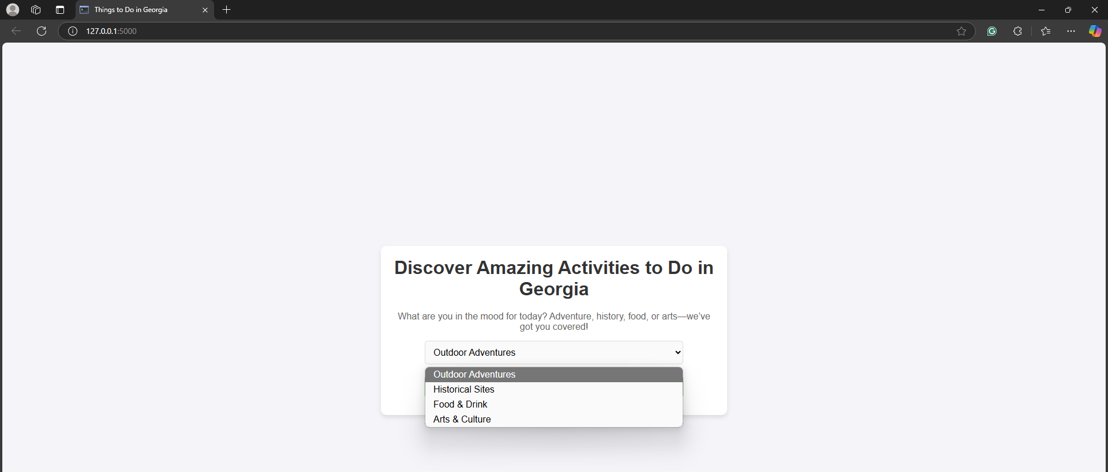
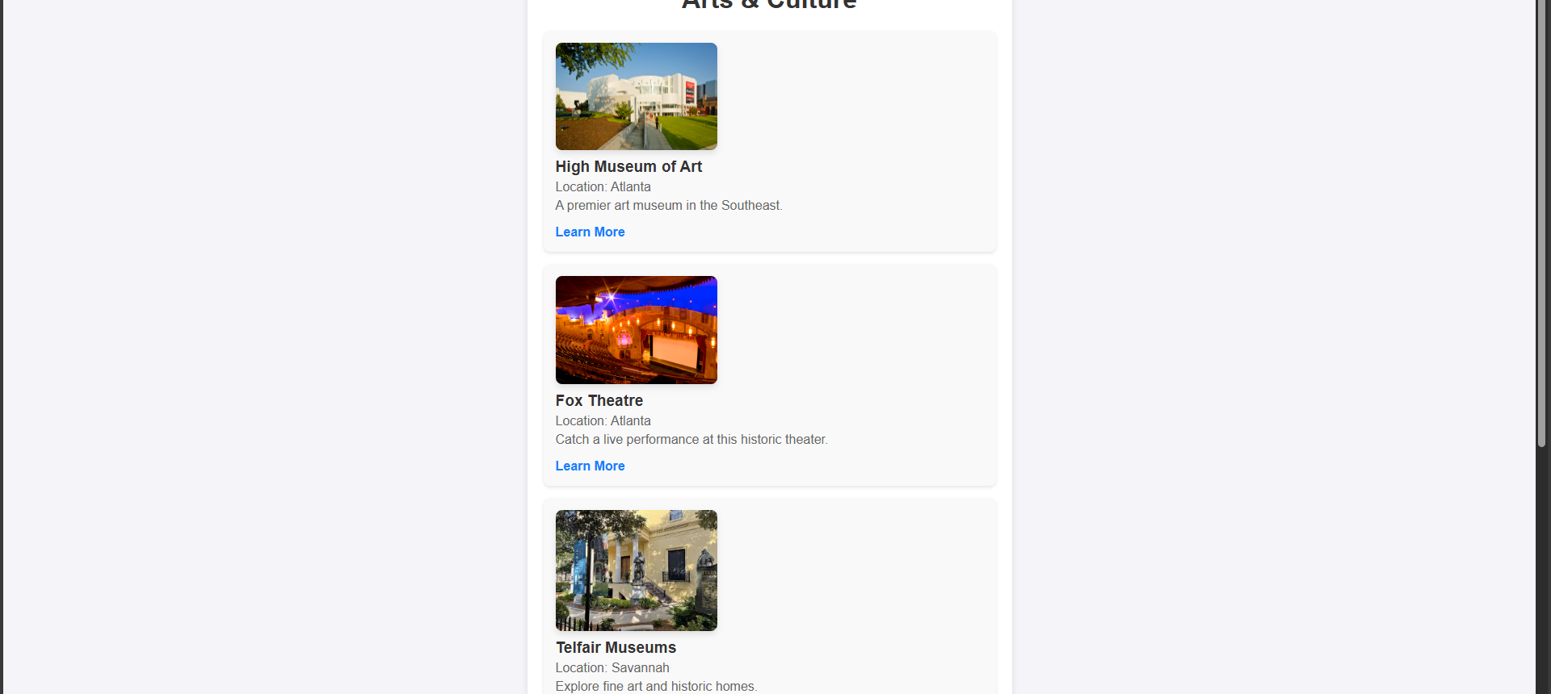
Todays Agenda
Help locals and tourists discover unique experiences throughout Georgia.
https://github.com/ksu-is/Today-s-Agenda
Coder: Isaac Cardenas

